Slide 1
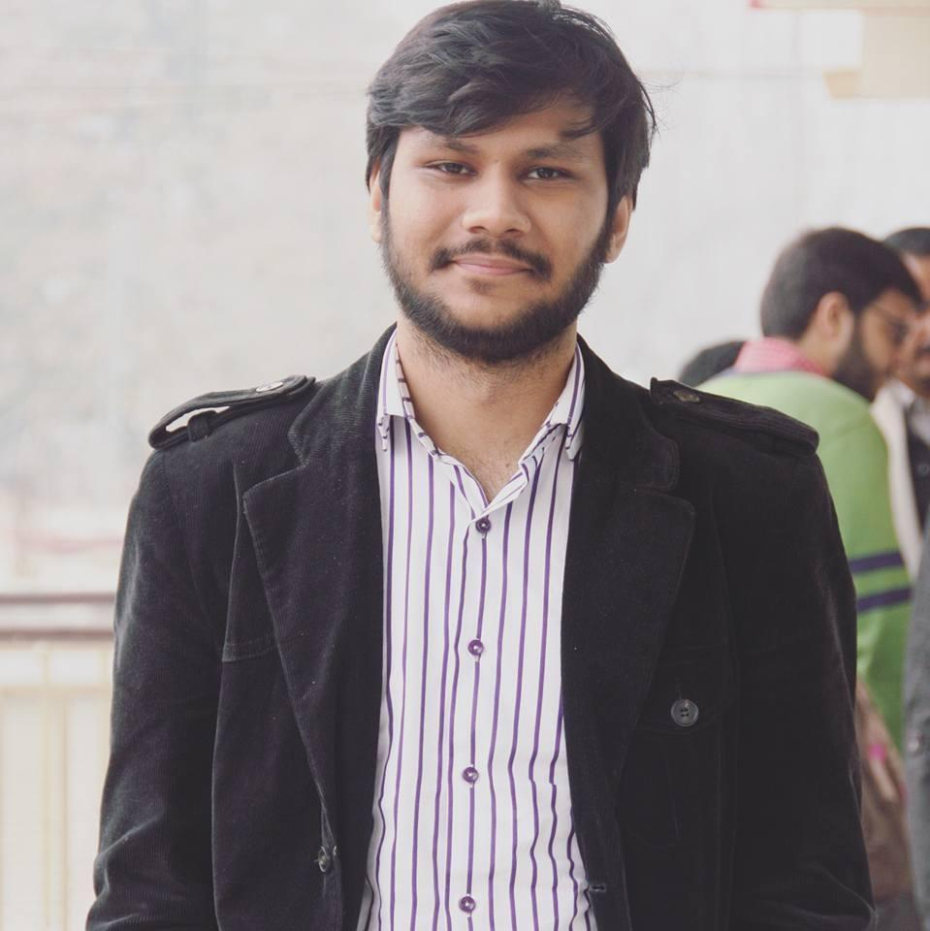
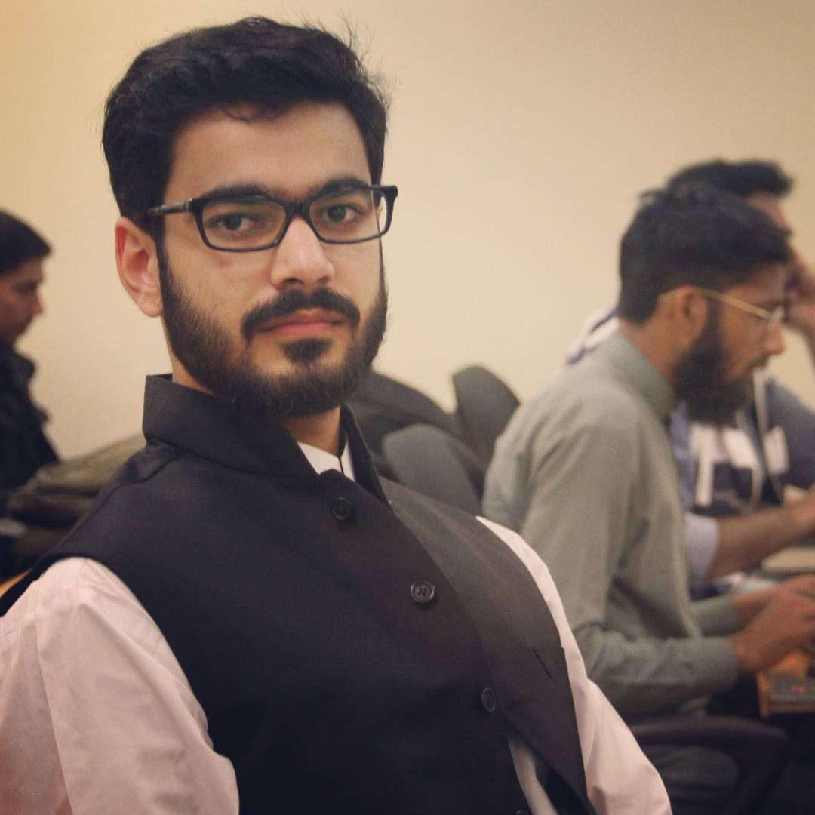

PGN App - Low-Fi Prototype
Shehryar Raza BSCS-13020
Abdul Jalil Mian BSCS-13062
Mariyah Kaleem BSCS-13065

Slide 2
The Problem
Under-developed eSports community
No proper platform for the eSports community in Pakistan

Slide 3
The Solution
eSports community app for the gamers which notifies the gamers about the upcoming nearby gaming events
Give the freedom to organizers to create their events on the app

Slide 4
Concept Sketches
Three concept sketches based on the needfindings and priorities
Different focus targets

Slide 5
UI Sketches
We picked top two designs based on the needfindings and priorities of the gamers

Slide 6
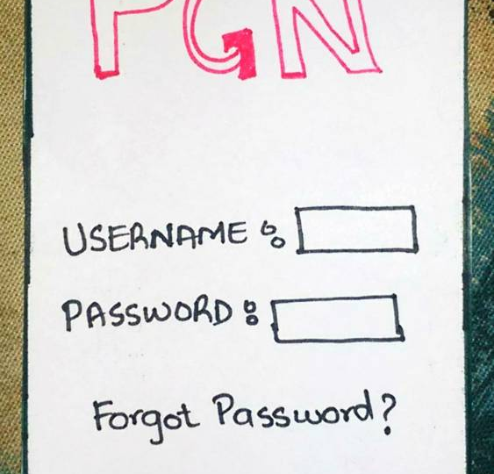
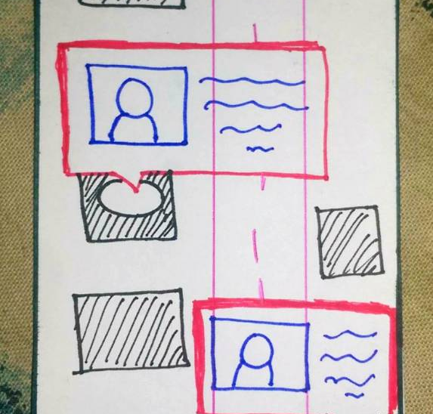
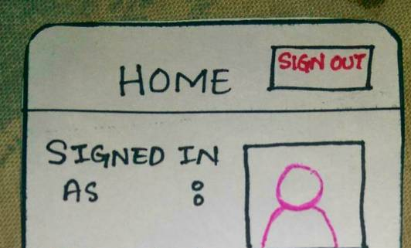
Design 1
We implemented “nearby events” feature in the design
We also added LAN meetup feature for the community
The organizers can add their own events on the app

Slide 7
Pros
Cons
App might be complicated to use for beginners
Notification of any nearby gaming event
General LAN meetup
A big eSports community present on the app
A very little commitment from the organizer to create the event

Slide 8
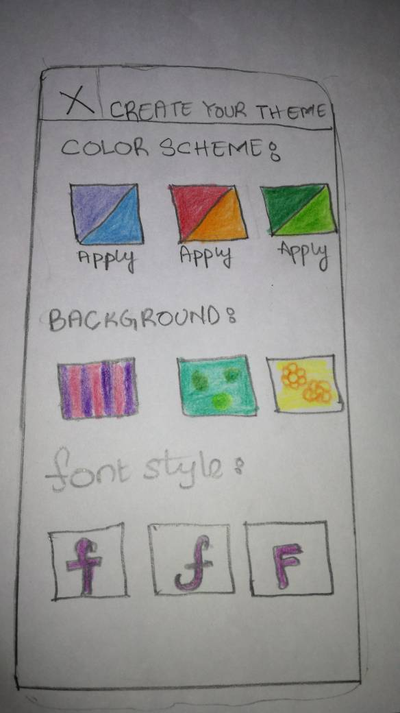
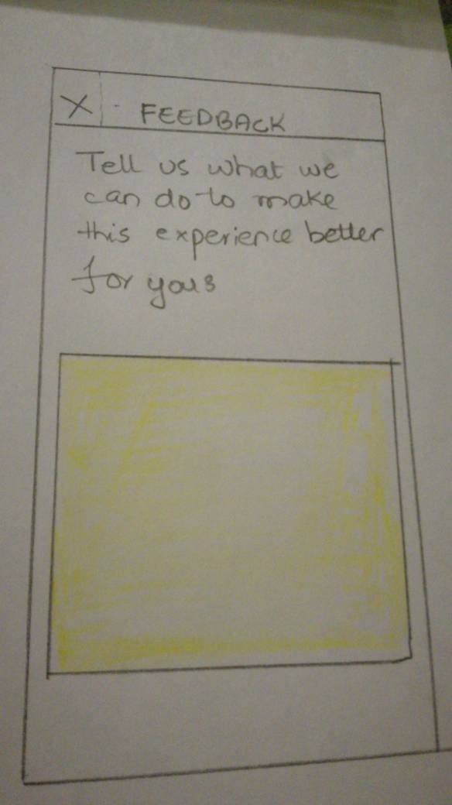
Design 2
We implemented the theme selection feature in the app
The feedback section was also added in the app

Slide 9
Pros
Cons
The focus of the design doesn’t suit the entire gaming community as some of them prefer the app with default settings
The app let you select the theme of your taste
The Feedback section let the users express their feelings about the app

Slide 10
Design Selection Rationale
We picked the Design 1 because it was fulfilling the needs of the gamers as well as the local organizers

Slide 11
UI Storyboards
Simple: Find upcoming events
Medium: Find players nearby and interact with other users
Complex: Create events

Slide 12
Interactive Prototype

Slide 13
Testing phase
We went to University of Lahore on a gaming event
25 gamers and participants tested the prototype of the app
We divided the testing phase into three parts

Slide 14
Testing phase
Simple task
The “nearby upcoming events” feature seemed to be feasible for 95% of the participants
The participants appreciated the implementation of such an app in Pakistan
Moderate task
About 75% of the participants appreciated the idea of “LAN meetups”
The rest of the gamers preferred to play alone
Complex task
Tested with the organizers of the event, the feature “create events” was a good move towards the development of gaming events
On the same side, the organizers were confused about the verification process

Slide 15
Questions?

